Slide 1
Bounded Rationality
Define the problem
Pouya amani lori

Slide 2
The “Rational Man”
In economic theory, a rational decision maker is an agent who has to choose an alternative after a process of deliberation in which he answers three questions:
•“What is feasible?”
•“What is desirable?”
•“What is the best alternative according to the notion of desirability, given the feasibility constraints?”

Slide 3
The “Rational Man”
Some of the assumptions buried in the rational man procedure:
Knowledge of the problem : The decision maker has a clear picture of the choice problem he faces: he is fully aware of the set of alternatives from which he has to choose.
Clear preferences : The decision maker has a complete ordering over the entire set of alternatives.
Ability to optimize : The decision maker has the skill necessary to make whatever complicated calculations are needed to discover his optimal course of action. His ability to calculate is unlimited, and 8 Chapter 1he does not make mistakes.

Slide 4
The “Rational Man”
Even if the decision maker does not behave in the manner described by the rational man procedure, it still may be the case that his behavior can be described “as if” he follows such a procedure.

Slide 5
The “Rational Man”
The rational man: The primitive of the procedure is a preference relation ≥ over a set A. Given a choice problem A ⊆ A, choose an element x* in A that is ≥-optimal (that is, x*≥ x for all x ∈ A).

Slide 6
choice functions that satisfy the consistency condition, even if they are not derived from a rational man procedure, can be described “as if” they are derived by some rational man.
One such classic example is what Simon termed the “satisficing procedure”

Slide 7
Consistency Condition
if for all A1 ⊆ A2 ⊆ A, if C(A2) ∈ A1 then C(A1) = C(A2).

Slide 8
Satisficing Procedure
A is set of alternatives
O is an order on A
S is subset of A that is satisfactory.
We have also a tie-breaking rule.
sequentially examine the alternatives in A, according to the ordering O, until you confront an alternative that is a member of the set S. Once you find such an element, stop and choose it.
For the case where no element of A belongs to S, use the tie-breaking rule that satisfies the consistency requirement (such as choosing the last element in A).

Slide 9
Example
A={Amani,Moshfegh,Hatami,Ghods,Navabakhsh,Kasiriha,Najafi,Teimoori}
The order we choose is the alphabetic ordering
S={Ghods,Kasiriha,Najafi}
Tie-breaking rule: choosing last name
C({Amani,Hatami,Kasiriha,Najafi,Teimoori})= Kasiriha
c({Amani,Kasiriha,Najafi})=Kasiriha
C({Amani,Hatami,Teimoori})=Teimoori because of tie breaking rule.

Slide 10
A special case of Satisficing Procedure is one where the set S is derived from two parameters, a function V and a number v*, so that S= {a ∈ A | V(a) ≥ v*}. The function V assigns a number to each of the potential alternatives, whereas v* is the aspiration level. The decision maker searches for an alternative that satisfies the condition that its value be above the aspiration level.

Slide 11
The Tendency to Simplify Decision Problems
Decision makers tend to simplify choice problems, probably as a method of saving deliberation resources.

Slide 12
Example
The primitives of the procedure are an ordering O and a preference relation ≥ on the set A. Given a decision problem A, pick the first and last elements (by the ordering O) among the set A and choose the better alternative (by the preference relation ≥) between the two.

Slide 13
Sample
A={a,b,c}
Ordering is alphabetical.
Preferences: b>a>c
C({a,b,c})=a
C({a,b})=b
{a,b} is subset of {a,b,c} but C({a,b,c}) ≠ C({a,b})
This is conflicting with the consistency condition.

Slide 14
The Search for Reasons
Choices are often made on the basis of reasons. If the reasons are independent of the choice problem, the fact that the decision maker is motivated by them does not cause any conflict with rationality.
Sometimes, however, the reasons are “internal,” that is, dependent on the decision problem; in such a case, conflict with rationality is often unavoidable.

Slide 15
Example
The primitive is a partial ordering D (a D b means a clearly dominate b). Given a problem A, for each alternative a ∈ A, count the number N(a) of alternatives in A that are dominated (according to the partial ordering D). Select the alternative a* so that N(a*) ≥ N(a) for all a ∈ A(and use a rule that satisfies the consistency requirement for tie-breaking).

Slide 16
Sample
A={a,b,c,d}
a D c , a D e , a D f , b D c , b D d
C({a,b,c,d,e,f})=a
C({a,b,c,d})=b
{a,b,c,d} is sub set of {a,b,c,d,e,f} but C({a,b,c,d,e,f}) ≠ C({a,b,c,d})
This is conflicting with the consistency condition.

Slide 17
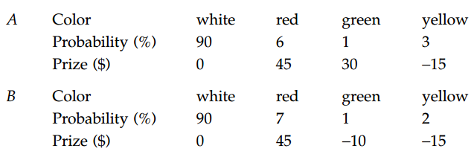
Experimental Evidence: The Tendency to Simplify a Problem
Consider the lotteries A and B. Both involve spinning a roulette wheel.

Slide 18
Experimental Evidence: The Tendency to Simplify a Problem
Facing the choice between A and B, about 58 percent of the subjects preferred A.

Slide 19
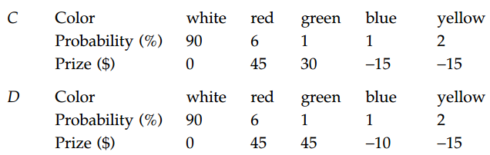
Experimental Evidence: The Tendency to Simplify a Problem
Now consider the two lotteries C and D:

Slide 20
Experimental Evidence: The Tendency to Simplify a Problem
The lottery D dominates C, and all subjects indeed chose D. However, notice that lottery B is, in all relevant respects, identical to lottery D(red and green in D are combined in B), and that A is the same as C (blue and yellow are combined in A).

Slide 21
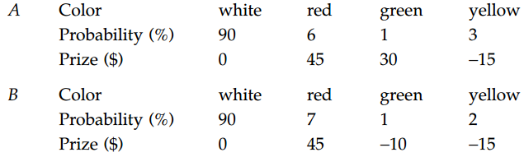
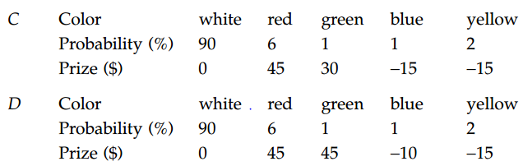
Experimental Evidence: The Tendency to Simplify a Problem

Slide 22
Experimental Evidence: The Tendency to Simplify a Problem
What happened? As stated, decision makers try to simplify problems. “Similarity” relations are one of the basic tools they use for this purpose. When comparing A and B, many decision makers went through the following steps:
1. 6 and 7 percent, and likewise 2 and 3 percent, are similar;
2. The data about the probabilities and prizes for the colors white, red, and yellow is more or less the same for A and B, and
3. “Cancel” those components and you are left with comparing a gain of $30 with a loss of $10. This comparison, favoring A, is the decisive factor in determining that the lottery A is preferred to B.

Slide 23
Experimental Evidence: The Search for Reasons
(x, y) represents a holiday package that contains x days in Paris and y days in London, all offered for the same price. All subjects agree that a day in London and a day in Paris are desirable goods. Denote, A= (7, 4), B= (4, 7), C= (6, 3) and D= (3, 6). Some of the subjects were requested to choose between the three packages A, B, and C; others had to choose between A, B, and D. The subjects exhibited a clear tendency to choose A out of the set {A, B, C} and to choose B out of the set {A, B, D}. Obviously, this behavior is not consistent with the behavior of a “rational man.” Given the universal preference of A over C and of B over D, the preferred element out of {A, B} should be chosen from both {A, B, C} and {A, B, D}.

Slide 24
Experimental Evidence: The Search for Reasons
Decision makers look for reasons to prefer A over B. Sometimes, those reasons relate to the decision problem itself. In the current example, “dominating another alternative” is a reason to prefer one alternative over the other. Reasons that involve relationships to other alternatives may therefore conflict with the rational man paradigm.

Slide 25
Reference: Modeling Bounded Rationality by Ariel Rubinstein

