Slide 1
بسم الله الرحمن الرحیم

Slide 2
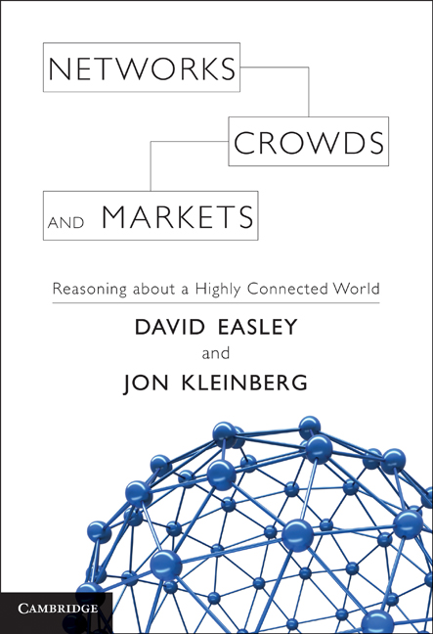
Evolutionary Game Theory
استاد راهنما:خانم دکتر خاکستری
دانشجو: صادق محمدحسینی طرقی
پاییز 92

Slide 3
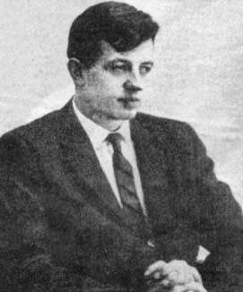
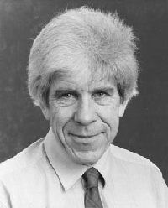
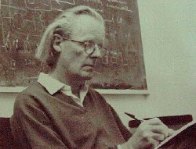
History
Has origins in work of R.A. Fisher [The Genetic Theory of Natural Selection (1930)
Fisher studied why sex ratio is approximately equal in many species
Maynard Smith and Price introduce concept of an ESS [The Logic of Animal Conflict (1973)]
Taylor, Zeeman, Jonker (1978-1979) provide continuous dynamics for EGT (replicator dynamics).

Slide 4
Introduction
Classic game theory and Nash Equilibrium
individual competition and population competition
Stability and evolutionary stability strategy

Slide 5
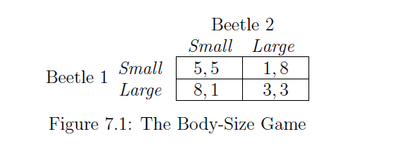
Example
Interaction Among Organisms with simple version

Slide 6
Evolutionarily Stable Strategies
We say the fitness of an organism in a population is the expected payoff it receives
from an interaction with a random member of the population.
We say that a strategy T invades a strategy S at level x, for some small positive
number x, if an x fraction of the underlying population uses T and a 1 − x fraction of the underlying population uses S.
Finally, we say that a strategy S is evolutionarily stable if there is a (small) positive
number y such that when any other strategy T invades S at any level x < y, the fitness of an organism playing S is strictly greater than the fitness of an organism playing T.

Slide 7
Evolutionarily Stable Strategies
برای بدست آوردن ESS با فرض این که جمعیت مغلوب ما با نرخ e وجمعیت غالب ما با نرخ 1-e درجمعیت حضور داشته باشند .استراتژی a استراتژی ESS است در صورتیکه a جعیت غالب باشد و دیگر استراتژی ها جمعیت مغلوب باشند پیامد انتظاریش بیشتر از دیگران باشد و هم اگر جمعیت مغلوب بود و دیگران
جمعیت غالب بود بازهم پیامد انتظاریش بیشتر از دیگران باشد.با این شرایط این استراتژی یک ESS خواهد بود.
راه دیگر برای بدست آوردن ESSهمانطور در ادامه خواهید دید نقطه تعادل نش اکید خواهد بود.در این صورت این استراتژی یک ESS خواهد بود و اگر تعادل نش اکید نبود باید شرایط بالا برای آن چک شود.

Slide 8
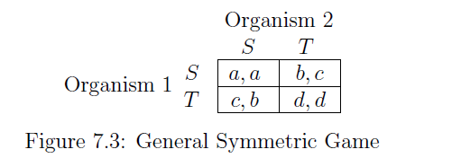
Find ESS in game
What is the expected payoff to an organism playing S in a random interaction in this population? With probability 1−x, it meets another player of S, receiving a payoff of a, while with probability x, it meets a player of T, receiving a payoff of b. Therefore its expected payoff is a(1 − x) + bx
What is the expected payoff to an organism playing T in a random interaction in this population? With probability 1−x, it meets a player of S, receiving a payoff of c, while with probability x, it meets another player of T, receiving a payoff of d. Therefore its expected payoff is c(1 − x) + dx

Slide 9
Solve example
با فرض small جمعیت جهش یافتگان با نرخ e در جمعیت باشند داریم
W(s)=5*e+1*(1-e)=1+4*e
W(l)=8*e+3*(1-e)=3+5*e W(l)>W(s)
حال اگر large ها جمعیت جهش یافتگان با نرخ e باشند داریم
W(s)=5*(1-e)+1*e=5-4*e
W(l)=8*(1-e)+3*e=8-5*e W(l)>W(s)
لذا جمعیت large ها یک ESS هستند که جمعیت در مراحل بعدی به سوی استراتژی آن ها خواهد رفت

Slide 10
Find ESS in game
Therefore, S is evolutionarily stable if for all sufficiently small values of x > 0, the
Inequality
a(1 − x) + bx > c(1 − x) + dx
In a two-player, two-strategy, symmetric game, S is evolutionarily stable precisely
when either (i) a > c , or (ii) a = c and b > d.

Slide 11
Relationship Between Evolutionary and Nash Equilibrium
If strategy S is evolutionarily stable, then (S, S) is a Nash equilibrium
it is possible to have a game where (S, S) is a Nash equilibrium, but S is not evolutionarily stable.
if (S, S) is a strict Nash equilibrium, then S is evolutionarily stable.

Slide 12
Evolutionarily Stable Mixed Strategies
There are at least two natural ways to introduce the idea of mixing into the evolutionary framework.
In the General Symmetric Game, p is an evolutionarily stable mixed strategy if there is a (small) positive number y such that when any other mixed strategy q
invades p at any level x < y, the fitness of an organism playing p is strictly
greater than the fitness of an organism playing q.
V (p, q) = pqa + p(1 − q)b + (1 − p)qc + (1 − p)(1 − q)d.

Slide 13
Evolutionarily Stable Mixed Strategies
we can write the condition for p to be an evolutionarily stable mixed strategy as follows: for some y and any x < y, the following inequality holds for all mixed strategies q #= p:
(1 − x)V (p, p) + xV (p, q) > (1 − x)V (q, p) + xV (q, q).

Slide 14
Relationship Between Mixed ESS and Mixed Nash Equilibria
If strategy S is Mixed evolutionarily stable, then (S, S) is a Mixed Nash equilibrium
it is possible to have a game where (S, S) is a Mixed Nash equilibrium, but S is not Mixed evolutionarily stable.

Slide 15
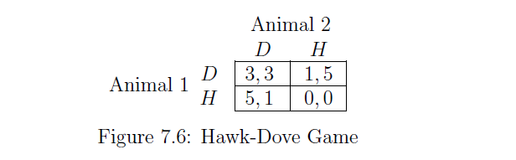
Solve a Sample
برای بدست آوردن ESS مختلط ابتدا تعادل نشmixed آن را بدست آورده حال با این احتمالات مانند مثال اول چک می کنیم که شرایط ESS را دارا هست اگر شرایط لازم را به دست آورد یک mixed ESS است در غیراین صورت فاقد این ویژگی است.با توجه به قضیه قبل سراغ احتمالات دیگر هم نمی رویم.
پیامد های انتظاری که در شرایط لازم باید چک شوند یک پیامد انتظاری احتمالاتی است، همانند پیامد انتظاری استراتژی های مختلط که فرمول آن را درصفحه 13 مشاهده نمودید.

Slide 16
با تشکر از حسن توجه شما

