Slide 1
بسم الله الرحمن الرحیم

Slide 2
هوش مصنوعی (دیدگاه کاربردی)
استاد راهنما: سعید ستایشی
دانشجو: صادق محمدحسینی طرقی
دانشگاه علوم اقتصادی
مهندسی دانش و علوم تصمیم
تابستان 92

Slide 3
مقدمه
در دنیای وسیع و پیچیده امروز نیاز به عامل های هوشمند که وظایف انسانی را در مدت کمی انجام دهند یا حداقل در انجام این وظایف ، ما را یاری نماید بیش از پیش احساس می شود.
هر چه بیش تر سعی در تکرار هوش انسان داشته باشیم بیش تر قادر به یادگیری درک و فهم آن خواهیم بود

Slide 4
پروژه سایک
سایک تلاش برای بازنمایی حجم زیادی از دانش بودکه در سال 1984توسط دوگ لنات در تگزاس شروع به کار کرد
فرایند به روز رسانی ،جستجو و دستکاری ساختار بزرگی از نمادها در چارچوب های زمانی امکان پذیر نمی باشد

Slide 5
سیستم های خبره
Domain Knowledge: Specialized knowledge about the problem.
An expert stores the domain knowledge in her/his Long Term Memory
Case Facts: Facts about the problem.
An expert obtains case facts and stores them in her/his Short Term memory (STM) to provide an advice.
The expert combines STM facts with LTM knowledge to reason about the problem.
The Expert then infers new problem formulation and may reach to The conclusion about the problem.

Slide 6
مولفه های سیستم های خبره
پایگاه دانش
بخشی از سیستم خبره که در برگیرنده دانش مربوطه می باشد
قوانین
راهی برای بازنمایی دانش در سیستم خبره که به صورت قوانین اگر آنگاه در سیستم پیاده سازی می شود
مهندس دانش
بدست آوردن دانش از طریق خبر گان و کد کردن و قرار دادن آن در سیستم خبره

Slide 7
مولفه های سیستم های خبره
حافظه کاری
بخشی از سیستم که شامل همه ی اطلاعات مورد نیاز مساله که از طریق کاربر یا پایگاه دانش بدست آمده است
مفاهیم
تمام اطلاعات بدست آمده از طریق ارتباط با کاربر یا پایگاه دانش بدست آمده را گویند
موتور استنتاج
پردازنده درون سیستمی که حقایقی موجود در حافظه کاری را با حوزه دانشی مربوط می سازد تا نتایج مطلوب استخراج شود

Slide 8
Reasoning
Deductive Reasoning
Analogical Reasoning
Inductive Reasoning
Common-Sense Reasoning
Abductive Reasoning
Case-Based Reasoning

Slide 9
Deductive Reasoning
Deducing new information from logically related known information.
Using problem facts or axioms and related general knowledge in the form of rules or implications.
Example:
Maryam is a programmer : Major Premise
All programmers are happy : Minor Premise
Therefore, Maryamis Happy : Consequence

Slide 10
Inductive Reasoning
For a set of objects, X={a, b, c, …} , if property P is true for a, and if P is true for b, and if P is true for c, …, then, P is true for all X
Lacks the mathematical exactness of deduction.
It is common in Expert Systems, because it does match human inference in the real
Example:
Minsky is a cat ,There four, Minsky has four legs.

Slide 11
Abductive Reasoning
Explains effects in terms of their causes.
This contrasts with deductive inference, witch works from causes to effect.
Example:
Implication: If it is raining
Axiom: Then grass in the garden will get wet.
Conclusion : It is raining?

Slide 12
Analogical Reasoning
Drawing analogies between two situation or object or
concept, looking for similarities and differences to guide
their reasoning.
Example:
TIGER Frame:
Specification-of: ANIMAL
Number-of-legs: 4
Eats: meat
Lives: India and southeast Asia
Color: tawny with strips.

Slide 13
Common-Sense Reasoning
Using common sense to quickly derive a solution.
It relies more on judgment than on exact logic.
It refers to as heuristics: A rule-of-thumb.
It is valuable in applications that require quick solution.
Example:
A loose fan belt usually causes strange noises.

Slide 14
Case-Based Reasoning (CBR)
CBR solves a new problem by finding a similar
past case and reusing in the new problem situation.
The case may be either reused to the solution
directly or, if necessary, adapted to the changed
circumstances of the current problem.
A case is a description of a problem together with details of the action that would be taken to respond to the problem.

Slide 15
Example
Step I.
Expert System: Does the car not start?
User: True.
Comment: The user asserts this into the working memory. Since this new fact supports Rule I, the expert system asserts into the working memory the rule’s conclusion.
User Asserts: The car will not start.
System Assert: The problem may be in the electrical system.
Step II.
Expert System: Is the battery voltage below 10 volts?
Comment: The working memory now contains the facts that support Rule II and the expert system asserts its conclusion into the working memory.
User Asserts: The battery voltage is below 10 volts.
System Asserts: The fault is a bad battery. Comment: The session now stops because there are no further rules to consider.
Rule I. IF The car will not start, THEN The problem may be in the electrical system.
Rule II.IF The problem may be in the electrical system , AND The battery voltage is below 10 volts,
THEN The fault is a bad battery.

Slide 16
سیستم های فازی
مجموعه های فازی
از جنبه تاریخی
منطق فازی
سیستم های فازی
کاربرد ها

Slide 17
History
The “Law of the Excluded Middle,” states that every proposition must either be True or False.
In the early 1900’s, Lukasiewicz described a three-valued logic. The third value can be translated as the term “possible,” and he assigned it a numeric value between True and False.
Knuth proposed a three-valued logic similar to Lukasiewicz’s.

Slide 18
History
Lotfi Zadeh, at the University of California at Berkeley, first presented fuzzy logic in the mid-1960's.
Zadeh developed fuzzy logic as a way of processing data. Instead of requiring a data element to be either a member or non-member of a set, he introduced the idea of partial set membership.
In 1974 Mamdani and Assilian used fuzzy logic to regulate a steam engine.

Slide 19
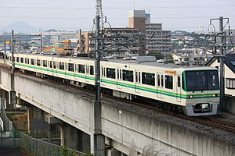
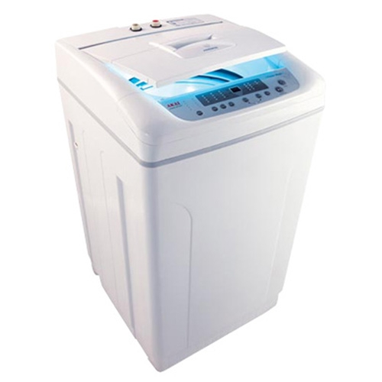
کاربرد ها

Slide 20
عدم قطعیت
As far as the laws of mathematics refer to reality they are not certain . and so far
As They are certain they do not refer to reality.
Probability theory
Possibility theory

Slide 21
درخت تصمیم
نحوه ی کارکرد
علت استفاده الگوریتم
انواع درخت تصمیم
معیار انتخاب بهترین ویژگی

